Slide 1

Social License and Trust in the Food System
Gate to Plate
February 15, 2018
Ellen Goddard,
Dept. of Resource Economics and Environmental Sociology, University of Alberta
egoddard@ualberta.ca

Slide 2
Definition of Social License
“Social License refers to the level of public trust granted to a corporate entity or industry sector by the community at large and its key consumer base.
Public trust is the belief that activities are consistent with social expectations and the values of stakeholders, and earned through industry engagement, operating practices, and expressed values. Social license is slow to build, but quick to erode. Industry tacitly garners public trust by doing what is right.”
http://www.realdirtblog.ca/what-does-social-license-mean-for-agriculture/

Slide 3
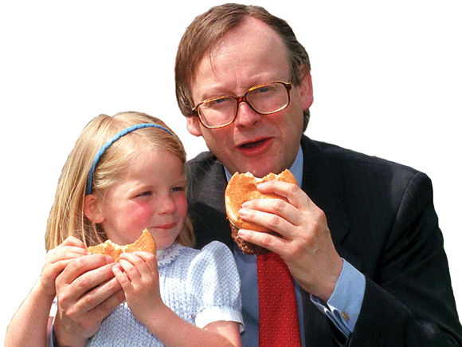
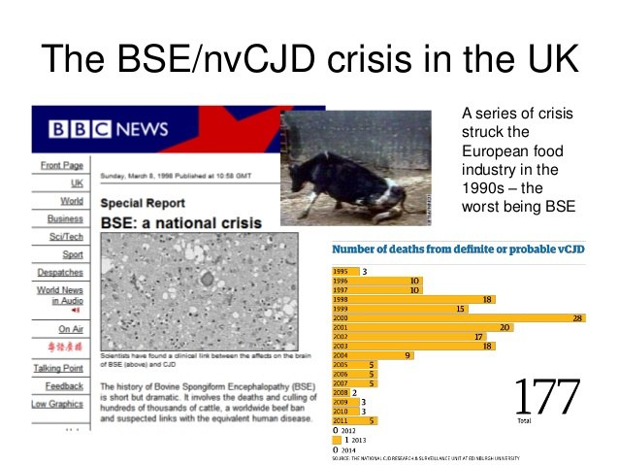
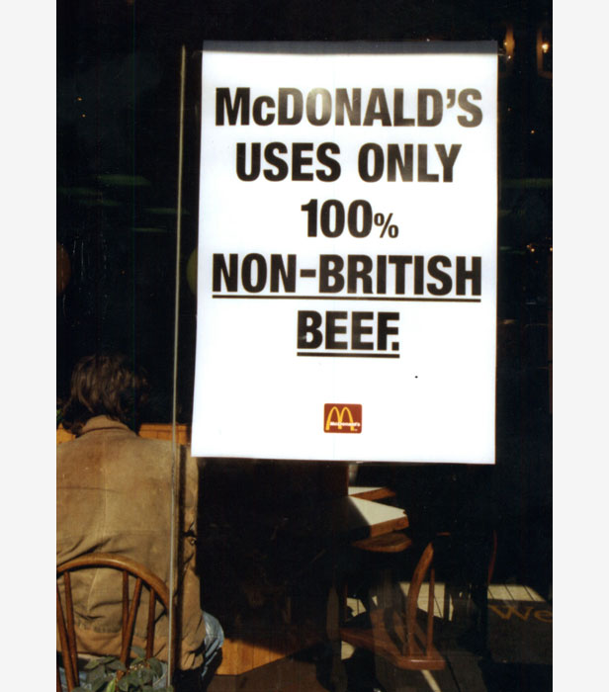
The press photographed Mr Gummer - then Agriculture Minister in the Conservative government - tucking into the burger with his little girl at a boat show in Suffolk on May 6 1990.
John Bostock, The development and implementation of European regulations for (fish and shellfish) traceability, Presentation given at the Symposium on seafood traceability and certification organised by Aqua-Int on behalf of the Korean Ministry of Oceans and Fisheries and Korean Fisheries Association, Busan, South Korea, 22 May 2015.

Slide 4
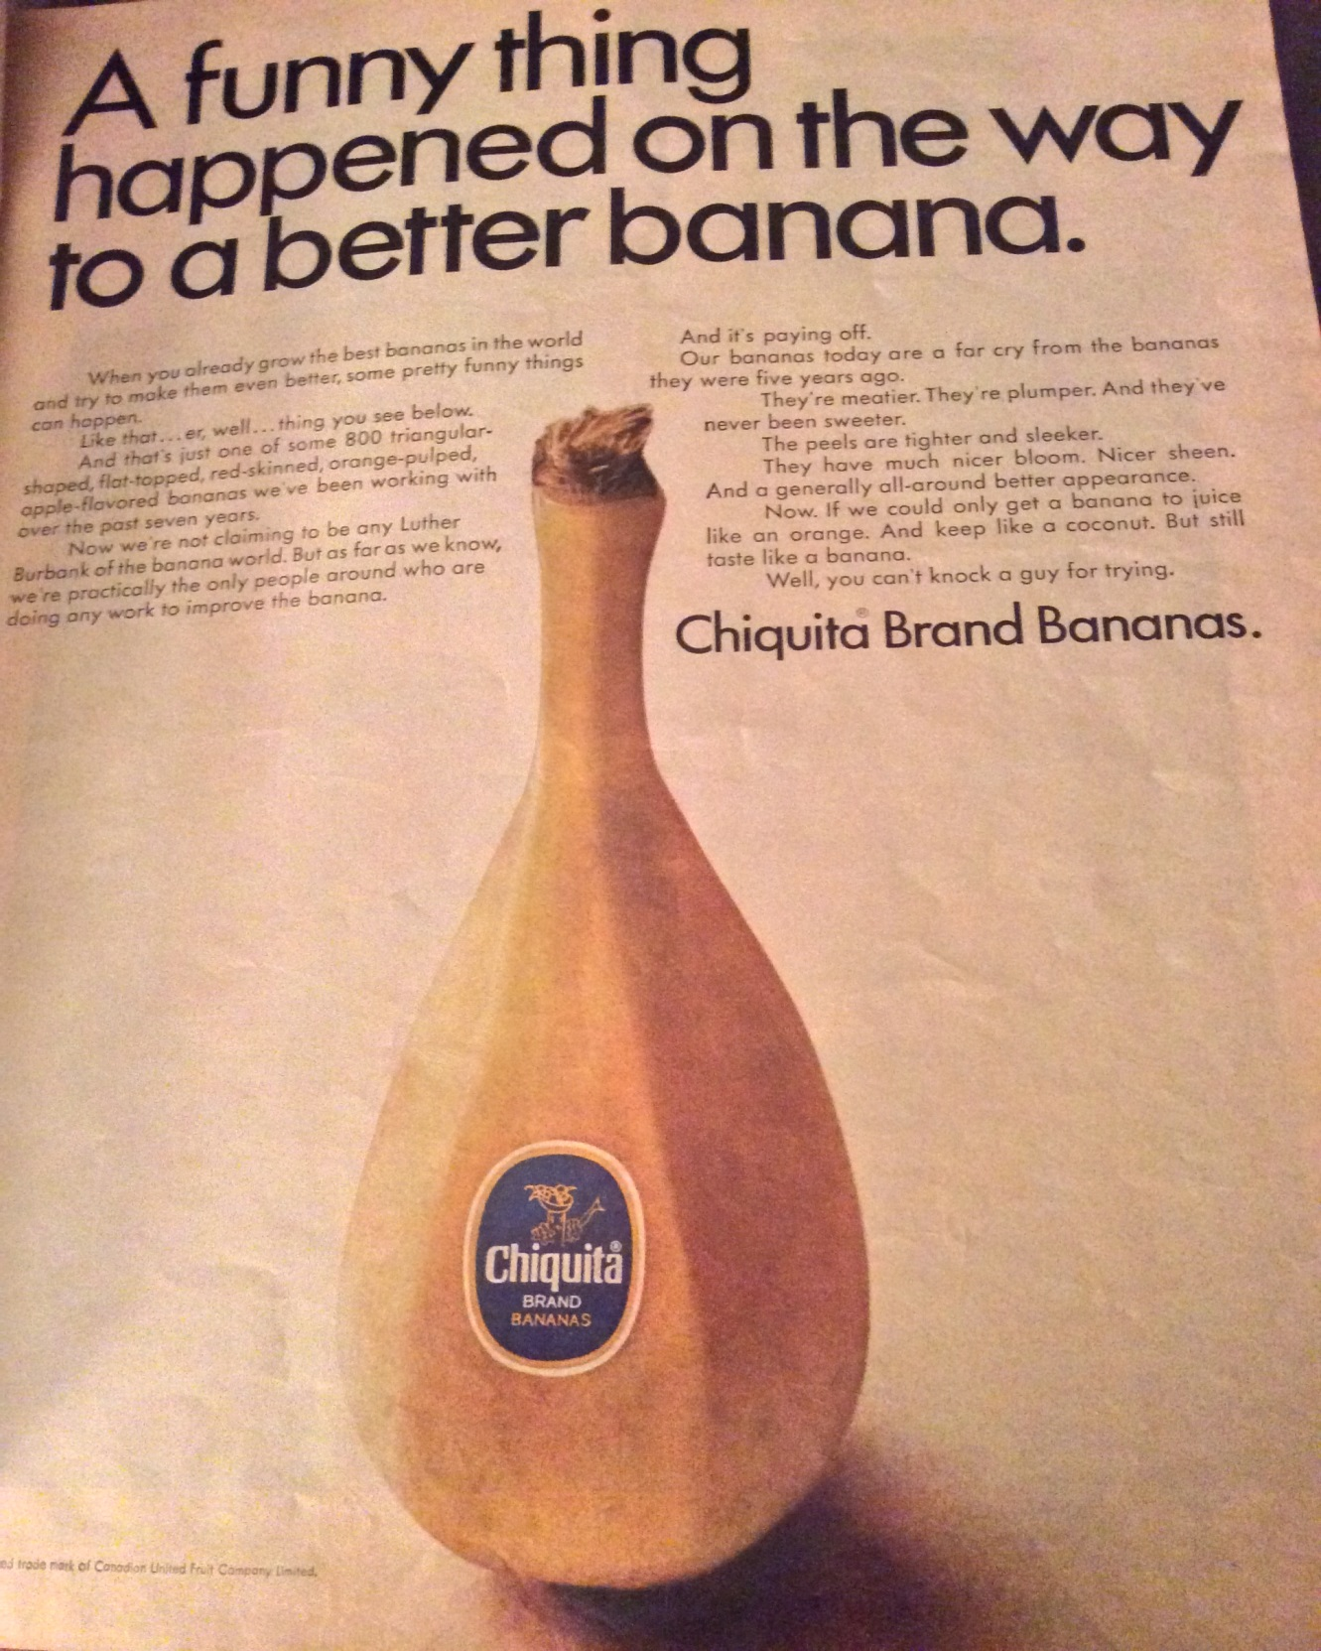
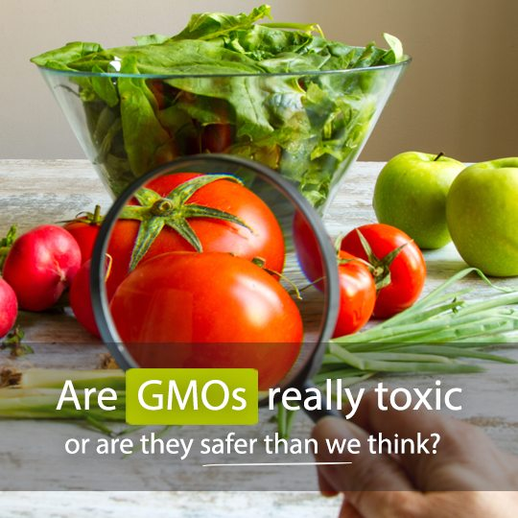
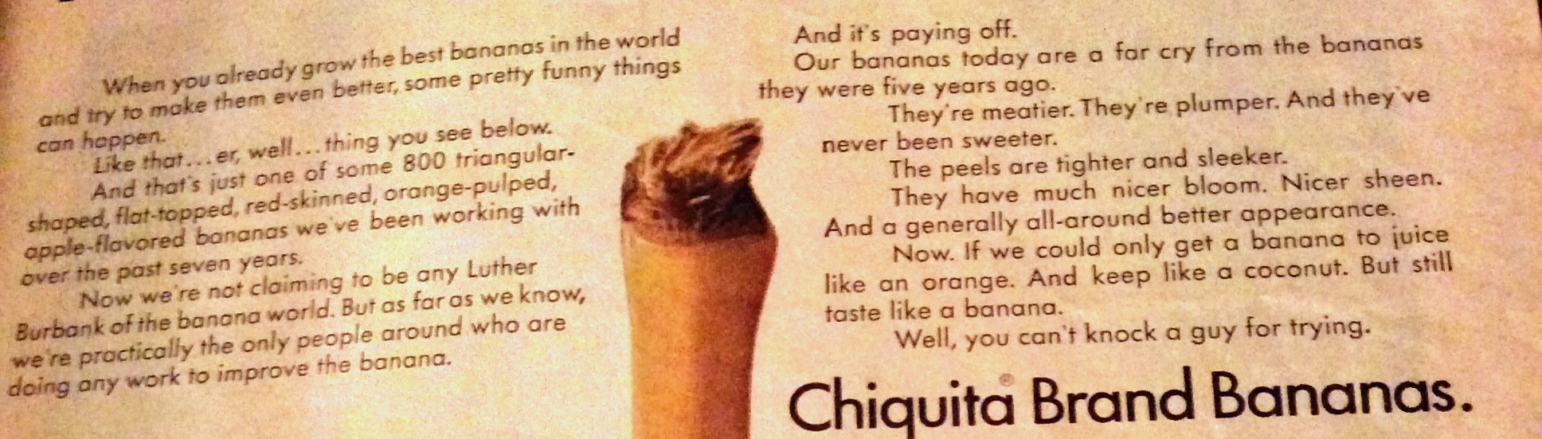
Second big Trust Issue
Chatelaine, July 1968

Slide 5

The new world of risks and opportunity
Drivers of change for Canadian agri-food sector:
The New One health:
Microbe-plant-animal--human ecology
Fourth Industrial Revolution: AI, CRISPR,
Big data, Remote sensing, E-commerce………………..
Public Trust:
Transparency Authenticity Food, Health, Environment
State of natural capital:
Air, Soil, Water, Biodiversity,
What does the future look like for the agriculture and agri-food sector? , The risks and opportunities for growth, by Ted Bilyea, Presented at the Canadian Agriculture & Agri-Food GenomicsForum, Toronto, November 29, 2017
Notes:
The powerful tools of the 4th industrial revolution such as omics can be of enormous benefit to agri-food if it comes from the perspective of one infinitely complex living system needing restoration and enhancement
Trust will require candid communication, transparency and accountability regarding how science and innovation leads ultimately to inclusive wealth.

Slide 6
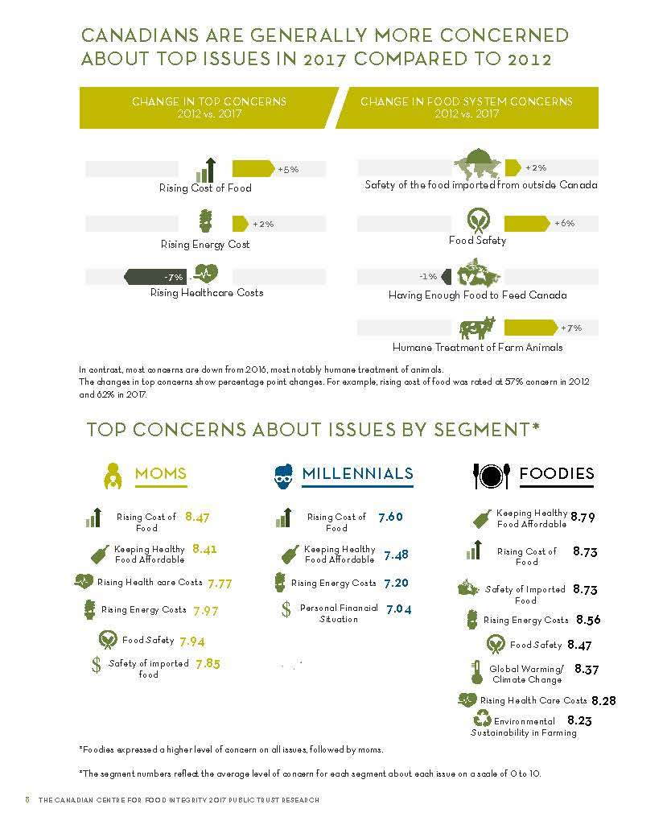


Slide 7

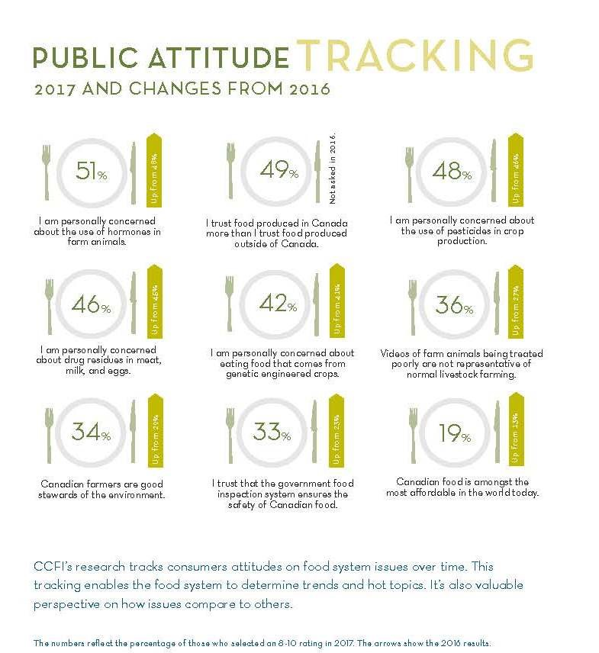

Slide 8
Measuring Trust
Glaeser et al. 2000, suggested a general indicator of trust (and a different measure of trustworthiness)– applied in many different countries as part of the General Social Survey
Nice broad indicator, regularly collected, comparable across countries

Slide 9
General Trust
Generally speaking, would you say that most people can be trusted?
Most people can be trusted
Can't be too careful in dealing with people
Don't know
Is this enough to know? – in our research we have found it to be a good predictor of trust in the food system and trust in different actions taken in the food system

Slide 11
Agent Trust farmers, government, retailers, manufacturers
Food safety context
Number of different ways to aggregate the individual components:
First two statements – Competence
Second two statements – Transparency
Third two statements – Commitment

Slide 12
Notes:
Measurements from 2012 to 2017 were single statements about trust and the measures from 2006 to 2011 were done with the six statements for each agent (like the previous slide)

Slide 14
More importantly
How do the different levels of trust relate to different decisions that individuals make – about food, about technology?
Some examples
  Higher levels of general trust – reduces risk perceptions and increases risk attitudes (meat)
  Looked at Canadian public interest in cloning (for meat or milk) –in general Canadians didn’t approve but when we looked at trust – we found that higher trust people (in general) were more willing to buy meat (milk) from cloned animals and had lower agreement that ‘cloning is wrong’

Slide 15
FAFH study
Linkages between general trust measures and trust in players involved in the food supply chain (government, manufacturers, retailers, restaurants, and farmers)
First Example
Impact of general trust and industry wide food safety trust on consumers’ stated preferences and identification of WTP for
  Turkey sandwich with vitamin content identified
  Turkey sandwich with sodium/fat content identified
  Turkey sandwich with a Health Check®
  at restaurants

Slide 16
Stated Choice Design

Slide 17
Table 5: Average Willingness to Pay for Turkey Sandwich with Added Attributes
 | Average $ | Standard | P-value
 | base sandwich price=$4.50 | Error
NO FAT
WTP higher vitamin content | $0.52 | 0.03 | [.000]
WTP higher sodium content | -$0.40 | 0.00 | [.000]
WTP Health Check™ | $0.46 | 0.03 | [.000]
WITH FAT
WTP higher vitamin content | $0.74 | 0.03 | [.000]
WTP higher fat/sodium content | -$2.75 | 0.09 | [.000]
WTP Health Check™ | $0.48 | 0.03 | [.000]

Slide 18
Cluster Assignment based on worry, general trust and trust in restaurants, manufacturers, retailers, farmers and restaurants

Slide 19
Willingness to Pay for Sandwiches by Trust Cluster
 | Higher Vitamin Content | Sodium | Health Check™
Low Trust | $0.49 | $-0.51 | $0.36
Medium Trust | $0.53 | $- 0.49 | $0.50
High Trust | $0.54 | $-0.45 | $0.57

Slide 20
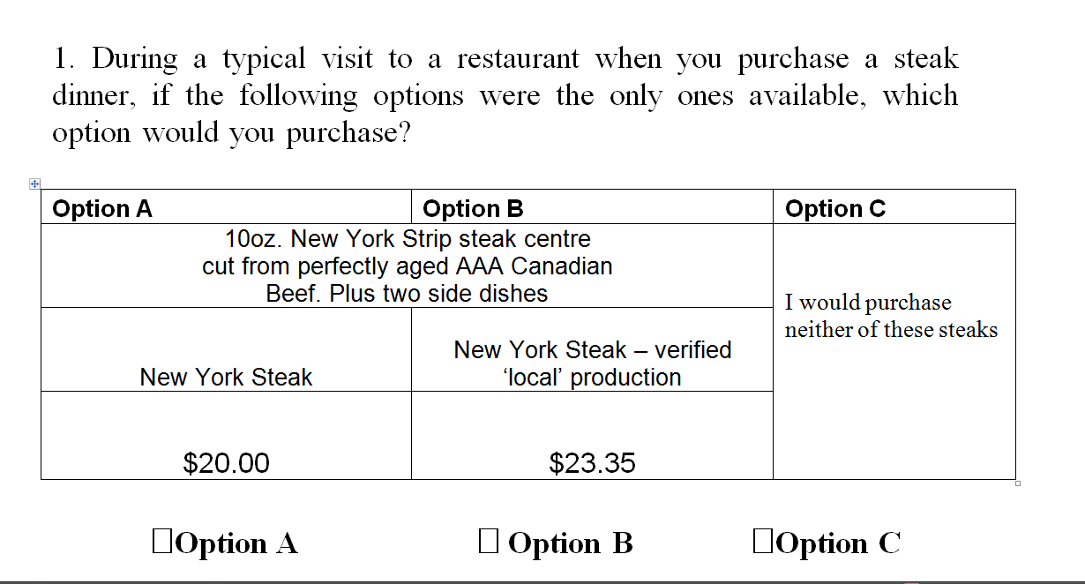
Second Choice experiments – sample choice set
Notes:
Websurvey in Canada in an online panel of NPD
March 2009
Analysed with multinomial logit analysis

Slide 21
Willingness to pay for Local and Traceable Attributes $/kg Steak (mean)

Slide 22
Interest in Traditionally Raised Pork versus Conventional Pork
Traditionally Raised Pork- from a family farm production setting, reared outdoors or in bedded settings, with no sub-therapeutic antibiotics or growth promotants, and no animal by-products in feed.
  Consumers with higher levels of trust were willing to pay higher premiums for traditionally raised pork as compared to those consumers who have lower trust which contradicted our research hypothesis
  We thought/hoped perhaps that traditionally raised pork (with certifications) might encourage those with lower trust to buy more pork

Slide 23
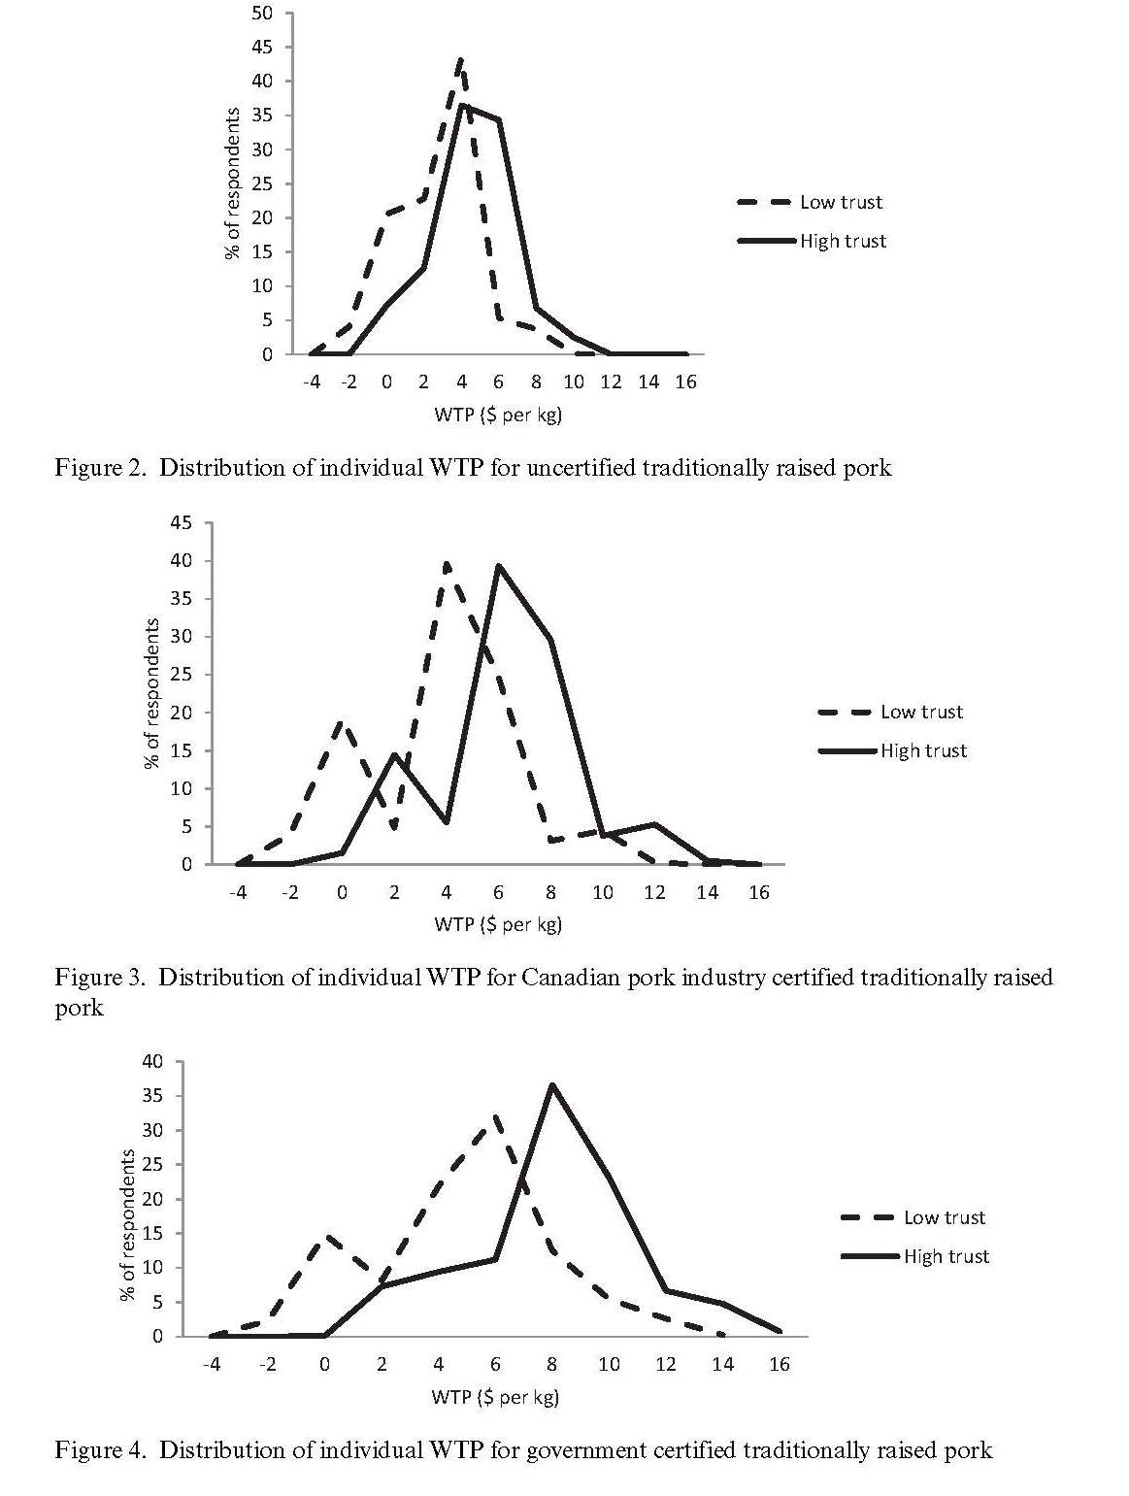
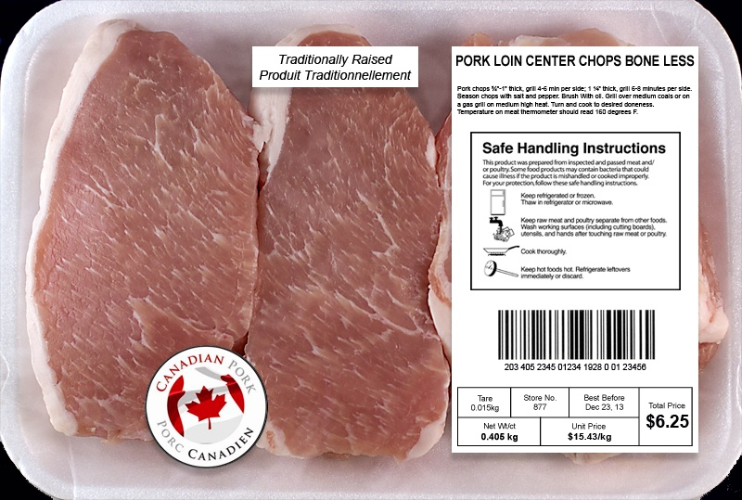
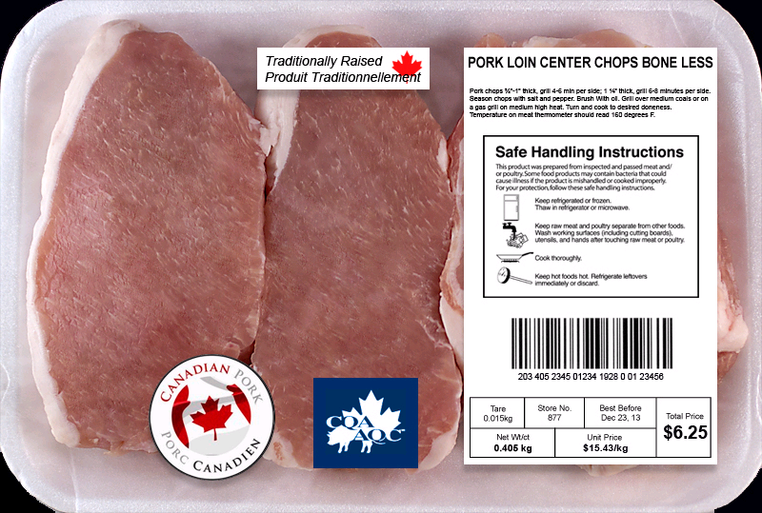
Experiment and Trust Results in WTP $ per kg

Slide 24
Specific Food Safety Questions across a number of surveys – 2008, 2009, 2011
Generally food is safe - (Strongly disagree to Strongly agree)
How much risk do you think there is to you personally of experiencing negative consequences from eating unsafe foods? - (Very Little to A Great Deal)
  Question presupposes the existence of unsafe foods

Slide 25
Odd result about Food Safety Concerns
 | Generally food is safe |  | Risk from a food safety incident
 | Parameter | P value | Parameter | P value
GOV COMPETENCE S1 2008 | 0.02 | [.291] | 0.07 | [.000]
GOV COMPETENCE S2 2009 | 0.06 | [.042] | 0.06 | [.031]
GOV COMPETENCE S3 2011 | 0.03 | [.072] | 0.03 | [.043]
GOV TRANSPARENCY S1 2008 | 0.05 | [.218] | -0.02 | [.624]
GOV TRANSPARENCY S2 2009 | 0.07 | [.006] | -0.09 | [.000]
GOV TRANSPARENCY S3 2011 | 0.07 | [.021] | -0.03 | [.202]
GOV CARE S1 2008 | 0.12 | [.002] | 0.01 | [.840]
GOV CARE S2 2009 | 0.19 | [.000] | 0.00 | [.879]
GOV CARE S3 2011 | 0.17 | [.000] | -0.08 | [.003]
For belief that foods are safe – government competence, transparency and care resulted in higher agreement
People who believed that the government was competent in food safety – had higher concerns about their own safety from eating unsafe foods
Beliefs in government transparency and commitment reduced people’s concerns about their own health from eating unsafe foods

Slide 26
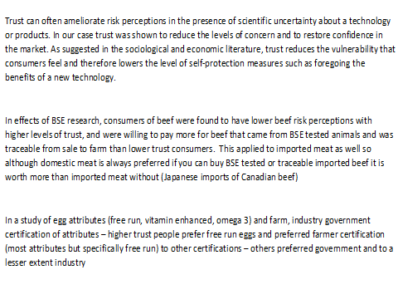

Slide 27
Pork Study 2015 Objectives
First Stated Preference | Second Stated Preference
Genomic Selection for Disease Resilience | Carnosine on Nutrient Content Claim
Genomic Selection for Feed Efficiency | Carnosine in Health Claim
Genomic Selection for Carnosine | Carnosine in Nutrition Facts Table
Use of Antibiotics | Protein Nutrient Content Claim
 | Verified Canadian Pork (Canada Pork)
To examine the Canadian consumer purchase preferences for different types of functional pork
To test the consistency of consumer purchase preferences with two sequential stated preference exercises in the same survey
Notes:
We attempt to meet the goal by addressing the two following objectives.
Since we include two SP, we are also interested in testing the consistency of …
A carnosine label, which contains three levels, and they are -

Slide 28
First choice experiment
All pork chops in this choice set have the following characteristics: These pork chops are produced on a Canadian family hog farm. The farm satisfies all of the criteria as Canadian Quality Assured (CQA®) for on farm safety protocols. The hogs are fed 100% grain (no animal by-products). The package of pork chops weighs .405 gm |  |  | Option D I would not purchase any of these pork chops
Pork Chop "A" | Pork Chop "B" | Pork Chop "C"
In addition, the hogs have been selectively bred (using genomics) to have higher feed efficiency (producing less manure and reducing the environmental footprint) | In addition the hogs have been selectively bred (using genomics) to have a significantly lower probability of having a number of hog contagious diseases. | In addition the hogs have been selectively bred (using genomics) to have higher levels of carnosine, a compound that has been shown to have anti-aging properties, In their pork.
No antibiotics are used in hog production | No antibiotics are used in hog production | Antibiotics are only used when prescribed by a veterinarian to treat a disease or infection
$10.01 per package | $10.01 per package | $10.01 per package
I would choose the following option :
OPTION A | OPTION B | OPTION C | OPTION D

Slide 29
First Choice Experiment: Regression Coefficients
Variables | Coefficient | Variables | Coefficient
Price | -0.26*** | Meat purchase frequency gen2 | 0.12*
None of the Products | -2.72*** | Meat purchase frequency gen3 | 0.15**
Genomics disease resilience (GEN1) | -2.49*** | Genomic familiarity gen1 | 0.19***
Genomics feed efficiency (GEN2) | -3.79*** | Genomic familiarity gen2 | 0.15**
Genomics carnosine (GEN3) | -2.68*** | Genomic familiarity gen3 | 0.14*
Antibiotic therapeutic use | 0.93*
Male gen2 | 0.21**
Male gen3 | 0.21**
Educ gen2 | 0.05* | Biotech support gen1 | 0.44***
Income gen3 | -0.004** | Biotech support gen2 | 0.83***
General trust gen1 | 0.49*** | Biotech support gen3 | 0.66***
General trust gen2 | 0.52*** | Biotech support antibiotic | 0.13*
General trust gen3 | 0.58***
Natural antibiotic | -0.08***
Myth nature 1 gen3 | -0.28*
Myth nature 2 gen3 | -0.28*

Slide 30
Human health risk and benefit perceptions for technologies,
Use of Genomics in Selective Breeding 2016 - 2017
Survey | 2016 | 2017 | 2017
Animal | Dairy cattle | Pigs | Pigs
Technology | Genomics | Genomics | Antibiotics
Context | Feed efficiency | Disease resilience | Disease treatment
Risk perceptions (1. not at all risky … 5. Very risky) | 2.59 (1.00) | 2.56 (0.99) | 2.98 (1.02)
Benefit perceptions (1. not at all beneficial … 5. very beneficial) | 3.07 (1.07) | 3.19 (1.06) | 2.49 (1.00)
 | Classification of respondents (%)
Supporters (Risk<Benefit) | 42.1 | 45.5 | 19.3
Doubters (Risk=Benefit) | 38.0 | 38.7 | 41.2
Opposers (Risk>Benefit) | 19.8 | 15.8 | 39.5
Sample size | 1688 | 1666 | 1666

Slide 31
Importance of Trust Variables in Level of Support for Use of Genomics
Doubters and Supporters as compared to Opposers
Survey | 2016 |  | 2017 |  | 2017
Animal | Dairy cattle |  | Pigs |  | Pigs
Technology | Genomics |  | Genomics |  | Antibiotics
Context | Feed efficiency |  | Disease resilience |  | Disease treatment
 | Doubters | Supporters | Doubters | Supporters | Doubters | Supporters
Government trust | 0.07 (0.76) | 0.09 (0.94) | 0.17 (1.60) | 0.12 (1.15) | 0.08 (1.11) | -0.04 (-0.45)
Industry trust | 0.42*** (3.29) | 0.41*** (3.09) | 0.46*** (3.18) | 0.40*** (2.72) | 0.82*** (8.00) | 1.19*** (8.31)
University /research trust | -0.04 (-0.38) | 0.22** (2.13) | 0.08 (0.75) | 0.43*** (3.70) | -0.13 (-1.50) | 0.09 (0.78)
Advocacy groups trust | -0.02 (-0.18) | -0.12 (-1.17) | -0.22* (-1.85) | -0.34*** (-2.76) | -0.37*** (-4.26) | -0.46*** (-4.00)

Slide 32
Anti-consumption
Interested in the people who do not eat certain food products
Does trust play a role in the decision not to eat
Examined for two large national surveys conducted in 2016/2017
One on dairy products – one on pork

Slide 33
How many respondents do not eat?
 | 2016 | 2017
Which of the following do you eat? (please check all that apply
I eat meat from most animals | 87.3% | 85.6%
I eat seafood and fish | 80.6% | 76.8%
I eat dairy products (milk, cheese, butter, yogurt) | 89.5% | 84.3%
I eat eggs | 87.9% | 83.9%
I eat none of the above | 1.43% | 1.83%
N | 1822 | 1804
Eat pork | - | 86.5%
N | - | 1799
How frequently do you eat dairy products (from cattle, sheep or other animals)/pork?
Less than once per month | 4.23% | 1.30%
One to three times per month | 7.30% | 7.65%
One to two days per week | 16.4% | 17.8%
Three to four days per week | 19.9% | 32.7%
Five to six days per week | 18.8% | 26.8%
Daily | 33.3% | 13.7%
N | 1630 | 1542

Slide 34
 | Dairy products (2016) |  | Pork (2017)
 | β | Marginal effect | β | Marginal effect
Trust in universities/research organizations | -0.02 (-0.33) | -0.003 (-0.33) | -0.15** (-2.36) | -0.03** (-2.38)
Trust in government | -0.15*** (-2.60) | -0.02*** (-2.61) | -0.05 (-0.94) | -0.01 (-0.94)
Trust in the food industry | -0.12 (-1.38) | -0.02 (-1.38) | -0.14* (-1.82) | -0.02* (-1.81)
Trust in advocacy groups | 0.26*** (3.13) | 0.04*** (3.14) | 0.10 (1.43) | 0.02 (1.43)
Animal attitude scale | 0.02 (1.05) | 0.003 (1.05) | 0.14*** (7.55) | 0.02*** (7.96)
Natural product interest | 0.03*** (2.59) | 0.005*** (2.58) | -0.01 (-0.59) | -0.001 (-0.59)
General health interest | 0.02** (1.98) | 0.003** (1.99) | 0.03** (2.37) | 0.005** (2.39)
Traditional news | -0.07 (-1.50) | -0.01 (-1.50) | -0.18*** (-3.94) | -0.03*** (-3.98)
Internet news and social media | 0.01 (0.19) | 0.002 (0.19) | 0.11** (2.23) | 0.02** (2.23)
Log likelihood | -526.2 |  | -557.2
McFadden Pseudo R² | 0.10 |  | 0.18
N | 1764 |  | 1738

Slide 36
 | 2016 |  |  | 2017
 | Food integrity concern | GM concern | Nanotechnology concern | Food integrity concern | GM concern | Nanotechnology concern
 | β (T-statistic)
Food integrity concern | - | 0.69*** (21.0) | 0.69*** (17.4) | - | 0.81*** (23.9) | 0.83*** (20.9)
Science benefit attitude | -0.05*** (-4.55) | -0.07*** (-4.37) | -0.07*** (-3.84) | -0.05*** (-3.83) | -0.10*** (-6.87) | -0.10*** (-6.10)
Trust
Generalized trust in people | -0.08* (-1.70) | -0.14** (-2.40) | -0.19*** (-2.82) | -0.12*** (-2.47) | -0.02 (-0.27) | -0.06 (-0.85)
Trust in government | -0.14*** (-4.99) | -0.12*** (-3.55) | -0.13*** (-3.25) | -0.09*** (-3.11) | -0.15*** (-4.19) | -0.07* (-1.85)
Trust in industry | -0.17*** (-4.36) | 0.04 (0.91) | 0.22*** (3.83) | -0.22*** (-4.84) | 0.08 (1.55) | 0.04 (0.65)
Trust in research organizations/universities | 0.06** (2.13) | -0.17*** (-4.42) | -0.19*** (-4.39) | -0.02 (-0.67) | -0.11*** (-2.70) | -0.20*** (-4.30)
Trust in advocacy groups | 0.16*** (5.14) | 0.17*** (4.27) | 0.17*** (3.62) | 0.21*** (5.15) | 0.15*** (2.88) | 0.16*** (2.86)
Scaled R² | - | 0.43 | 0.43 | - | 0.50 | 0.49
Sample | 1633 | 1633 | 1195 | 1618 | 1618 | 1240

Slide 37
Thanks
Acknowledgements to many funders
  Alberta Prion Research Institute
  PrioNet
  Genome Canada Genome Alberta
  University of Alberta
And to many colleagues and graduate students - including Albert Boaitey, Violet Muringai, Ashwina Aubeeluck, Arenna

