Slide 1

Building Public Trust in Agriculture
Gate to Plate
February 15, 2018
Ellen Goddard,
Dept. of Resource Economics and Environmental Sociology, University of Alberta
egoddard@ualberta.ca

Slide 2
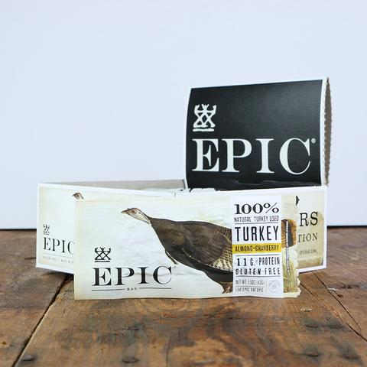
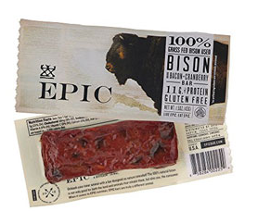
SNACKING – The New Way of Eating – Good or Bad for Meat?
Fifty-six percent of all snacking occasions reflect some need for nourishment, or snacking that addresses hunger and provides sustained energy. Key attributes of these snacks include whole grains, fiber, protein, fat, probiotics and minimal sugar. Examples include Greek yogurt, fruits and vegetables, nut and granola bars, and ready-to-drink tea, water and smoothies.
Thirty-four percent of snacking occasions reflect some need for optimization, or snacking that provides quick energy, recovery, mental focus or stress management, such as products with protein, caffeine, vitamins and minerals, antioxidants and botanicals. Examples include energy and sports drinks, energy and granola bars, meat snacks, kombucha and coffee.
TURKEY ALMOND CRANBERRY BAR
BOX OF 12
$ 30.00 $ 34.00
The Future of Snacking, http://www.foodbusinessnews.net/articles/news_home/Consumer_Trends/2017/03/Forecasting_the_future_of_snac.aspx?ID=%7B37D729D8-89D2-42D7-861E-A8ED66D6DCD7%7D&cck=1

Slide 3
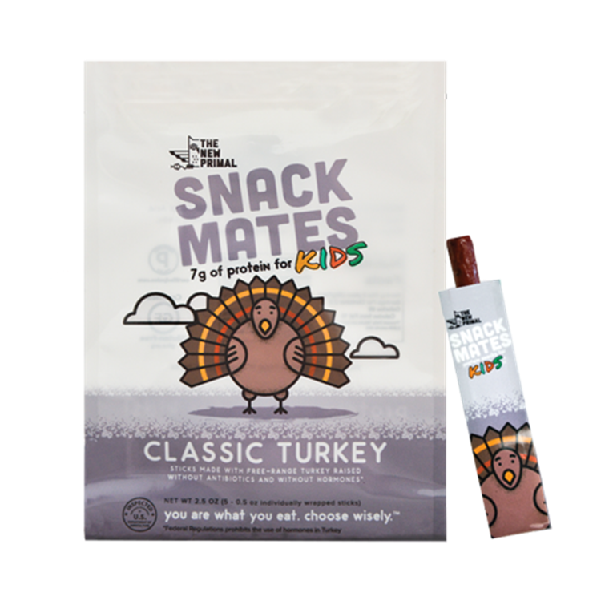

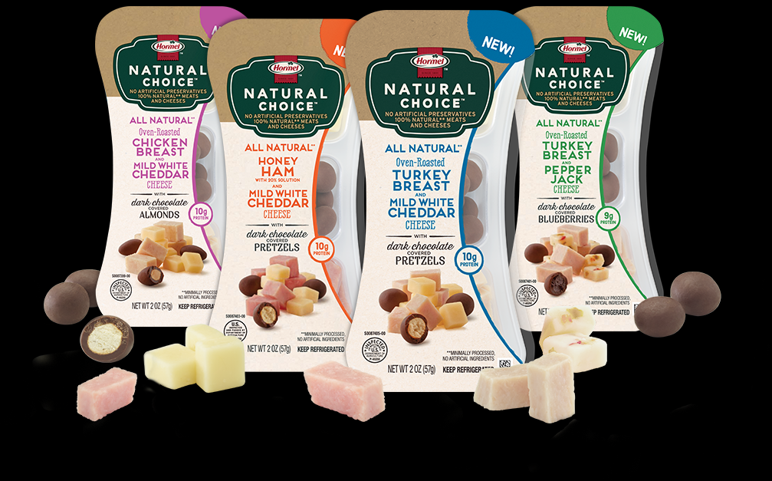
CONVENIENCE is becoming a bigger driver in snacking meat products

Slide 4
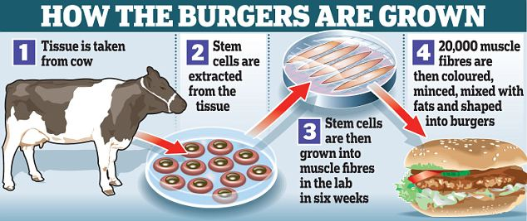
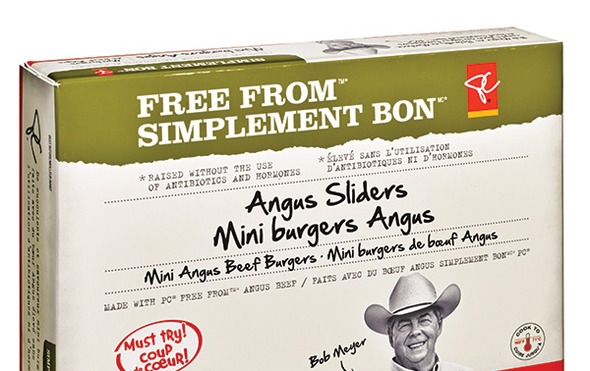
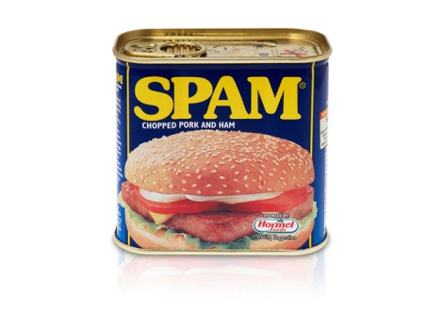

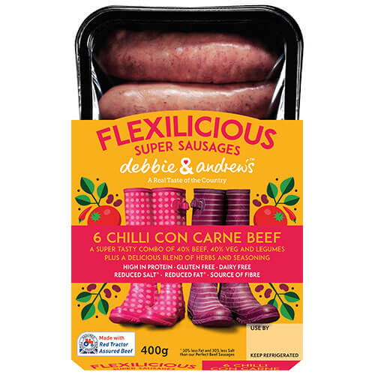
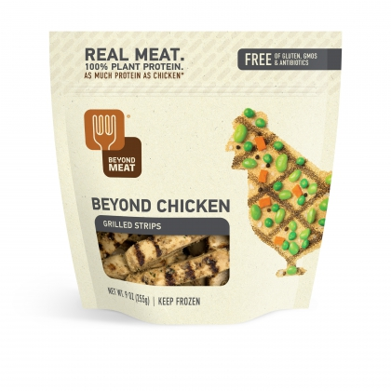

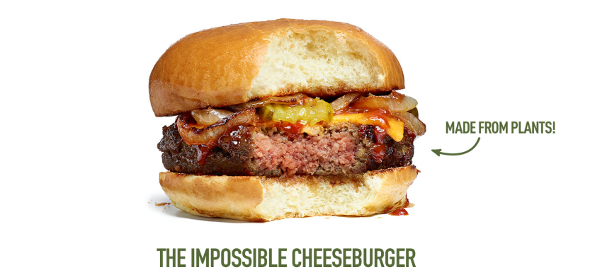
Traditional Meat
Plant Based Meat
Cellular Meat
Spam celebrates
80 year anniversary

Slide 5
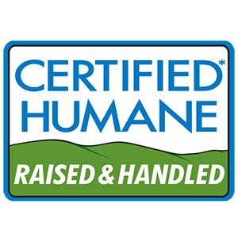
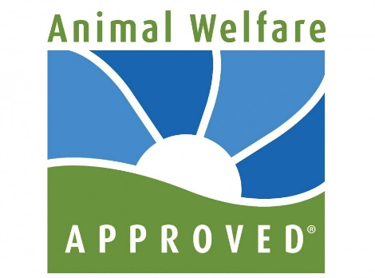

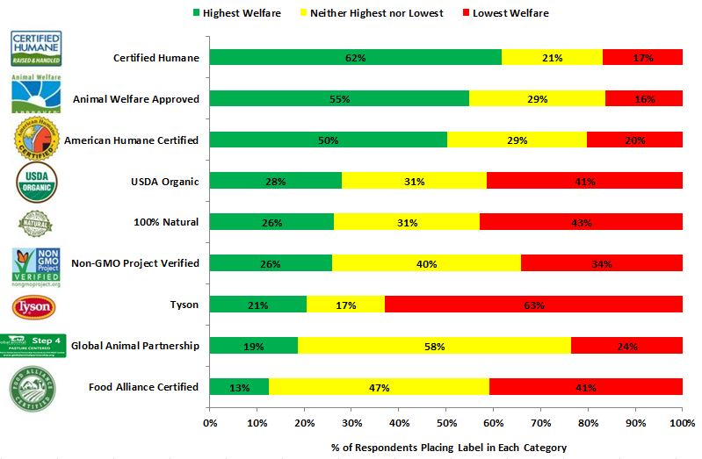
ANIMAL WELFARE
Plethora of Labels = Confusion?
Verification (Ranking) Becomes Important
What is the Animal Protection Index?
The Animal Protection Index is a new interactive tool from World Animal Protection. We have ranked 50 countries worldwide on how well their legislation protects animals. Never before has a more comprehensive or ambitious project in animal protection been completed. You can access each country’s report and see how they perform on animal protection policy and legislation.
http://jaysonlusk.com/blog/2015/12/15/food-demand-survey-foods-december-2015

Slide 6
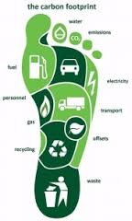


Sustainability increased labeling options and Even More Rankings
Financial Times Stock Exchange’s FTSE4Good Index Series,
Dow Jones Sustainability Indices (DJSI),
Canadian Corporate Knights’ Global 100 index,
In the United States, Newsweek’s Green Rankings

Slide 7


Interesting Approaches
Better for you. Better for Colorado. Look for the Colorado Proud logo at grocery stores, farmers' markets, garden centers and restaurants. By buying locally grown, raised and processed food and agricultural products, you are receiving high quality fresh products and helping Colorado's economy, local farmers, ranchers, greenhouses, manufacturers and processors in your area.

Slide 16
And so what?
The importance of trust to decision outcomes is not in question
When trust is seriously affected – what then?
Often the first reaction is to say – we need to educate the ‘untrusting’ – called a Knowledge Deficit approach
  states that the public is willing and able to process information if it is available. Therefore, a lack of public support or participation is caused by a lack of information available to the public.
  Dickson, D. 2005. The Case for a ‘deficit model’ of science communication. Science and Development Network.

Slide 17
Cultural Cognition
The cultural cognition of risk, sometimes called simply cultural cognition, is the hypothesized tendency of persons to form perceptions of risk and related facts that cohere with their self-defining values.
A study conducted by Cultural Cognition Project researchers (using a nationally representative U.S. sample) found that ordinary members of the public do not become more concerned about climate change as their science comprehension increases. Instead, the degree of polarization among cultural groups with opposing predispositions increases.
Kahan, Dan; Peters, Ellen; Wittlin, Maggie; Slovic, Paul; Ouellette, Lisa Larrimore; Braman, Donald; Mandel, Gregory (2012), "The polarizing impact of science literacy and numeracy on perceived climate change risks", Nature Climate Change, 2: 732–735, doi:10.1038/nclimate1547

Slide 18
Acceptance of GMO
Jan M. Lucht, Public Acceptance of Plant Biotechnology and GM Crops, Viruses 2015, 7, 4254-4281; doi:10.3390/v7082819
It has become increasingly clear that information strategies focusing just on the factual aspects do not convince many consumers of the benefits of GM foods. In a large-scale experiment with European consumers, information material about food biotechnology and product examples with health and sustainability benefits failed to change the general attitude of consumers, and product choice was even affected in a negative way.
Consumers have only a limited knowledge about new technologies such as genetic engineering, and therefore often feel unable to decide for themselves whether GM crops might carry risks, and how to weigh that against possible benefits. They therefore depend on people they consider trustworthy experts to make informed decisions, which they can use as guide to establish their own positions. Therefore, trust plays an important role in the assessment of GM food by lay persons

Slide 19
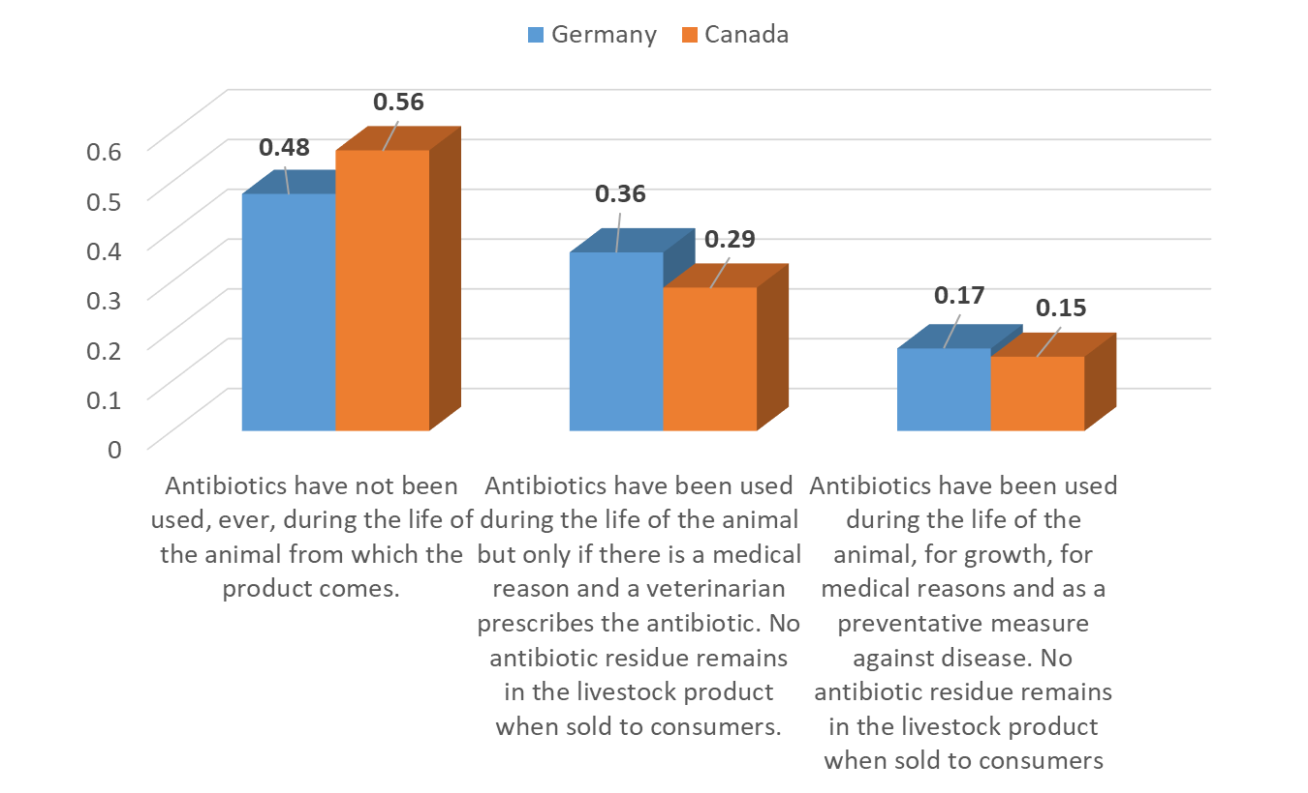
To you, what does Antibiotic-Free Mean?
% agreement with each definition

Slide 20
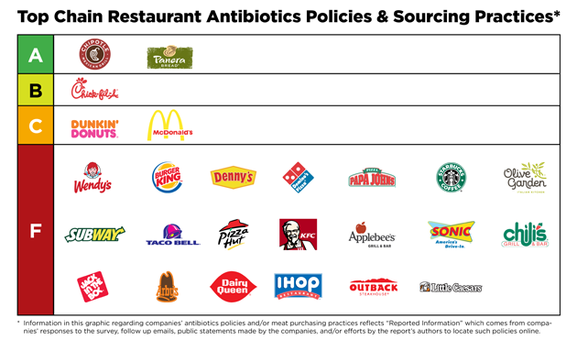
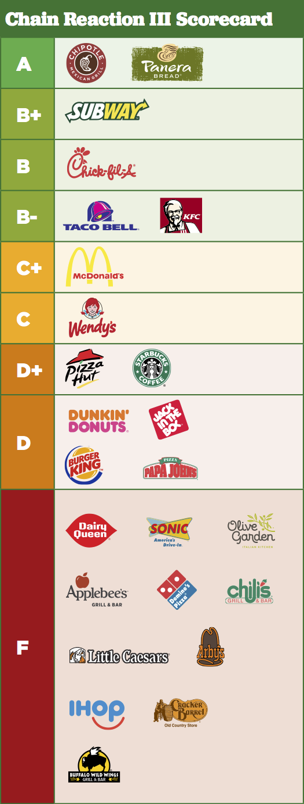
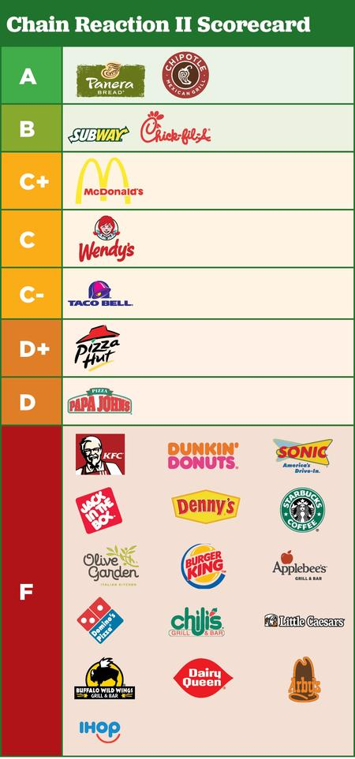
http://www.foe.org/projects/food-and-technology/good-food-healthy-planet/chain-reaction
https://www.nrdc.org/sites/default/files/restaurants-antibiotic-use-report-2016.pdf
https://consumermediallc.files.wordpress.com/2017/09/scorecard.png

Slide 21
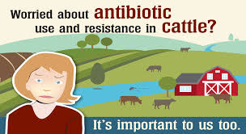

Slide 22
https://www.edelman.com/trust-barometer

Slide 23
https://twitter.com/farmsofcanada?lang=en

Slide 24
http://www.realdirtonfarming.ca/

Slide 25
https://www.bestfoodfacts.org/about-the-experts/

